Slide 1
Number Systems and Data Representation

Slide 2

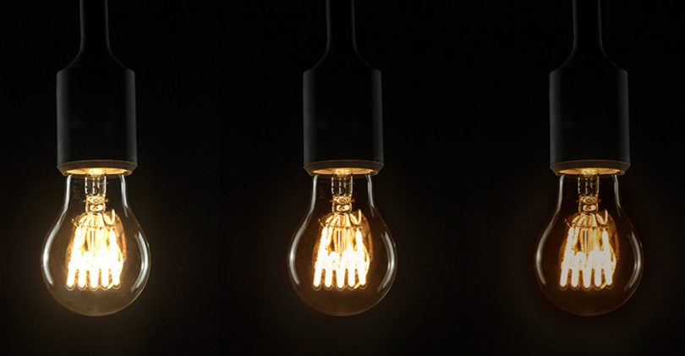
Number Systems
We work with decimal numbers (0-9)
Modern computers do not work with decimal numbers – they use binary numbers (0-1)
Why? Because electronic devices are most reliable when designed for two-state (binary) operations
Binary/Digital
Analog
1 volt
0.75 volts
0.50 volts

Slide 3
Decimal Odometer
When a car is just manufactured, it has run 0 kilometers
Hence its odometer shows 00000
After running for 1 kilometer, the odometer shows 00001
This goes on up to 00009
After 10 kilometers are complete, the units wheel turns back from 9 to 0 and a tab on this wheel forces the tens wheel to advance by 1, so we now have 00010

Slide 4
Reset and Carry
What has happened?
The units wheel has reset to 0 and has sent a carry to the tens wheel
This action can be called as reset and carry
The other wheels also reset and carry
After 999 kilometers, the odometer shows 00999
After 1 more kilometer, the unit wheel resets and carries, the tens wheel resets and carries, the hundreds wheel resets and carries, and the thousands wheel advances by 1
So, after 999 kilometers, the odometer shows 01000

Slide 5
Digits
The numbers on each odometer wheel are called as digits
The decimal number system uses ten digits, 0 through 9
In a decimal odometer, each time the unit wheel runs out of digits, it resets to 0 and sends a carry to the tens wheel
When the tens wheel runs out of digits, it resets to 0 and sends a carry to the hundreds wheel
And so on …

Slide 6
Binary Odometer
Computers work with just two voltage pulse levels, say -15v and +5 v
We can codify -15v as 0 and +5v as 1
Binary means two
The binary number system uses only two digits: 0 and 1
The other digits 2-9 are not used
So, a binary odometer will only have two digits: 0 and 1
When each wheel turns, it displays 0 and then 1
Then it is back to 0 and again back to 1
And so on …

Slide 7
A Car with a Binary Odometer
Starting position
0000 Zero
After 1 kilometer
0001 One
After 2 kilometers, reset and carry of units wheel
0010 Two
After 3 kilometers
0011 Three
After 4 kilometers, reset and carry of units wheel and the second wheel; the third wheel advances by 1
0100 Four

Slide 8
A Car with a Binary Odometer
After 4 kilometers, reset and carry of units wheel and the second wheel; the third wheel advances by 1
0100 Four
Next few values
0101 Five
0110 Six
0111 Seven
After 8 kilometers, reset and carry of units wheel, the second wheel, and the third wheel; the fourth wheel advances by 1
1000 Eight

Slide 9
A Car with a Binary Odometer
After 8 kilometers, reset and carry of units wheel, the second wheel, and the third wheel; the fourth wheel advances by 1
1000 Eight
After 9 kilometers, we have
1001 Nine
After 10 kilometers, we have
1010 Ten
And so on ..

Slide 10
Binary Numbers
A binary odometer displays binary numbers, which are strings of 0s and 1s
Binary 0000 stands for decimal 0
Binary 0001 stands for decimal 1
Binary 0010 stands for decimal 2
Binary 0011 stands for decimal 3
For large decimal numbers, binary numbers are long
For example, decimal 42 in binary is 101010

Slide 11
Exercise
A binary odometer has four wheels. What are the successive binary numbers?

Slide 12
Bit
Binary Digit = Bit
A binary number 1010 has 4 bits
A binary number 100100 has 6 bits
One bit is stored in one transistor

Slide 13
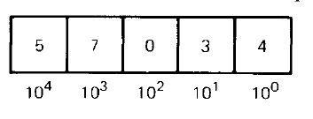
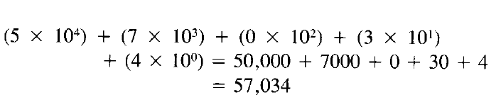
Decimal Weights
Each digit in a decimal number has a positional weight
Here, the weights are units, tens, hundreds, thousands, and so on
Sum of all the digits multiplied by their respective weights gives the total value of the number
Example: 57034 in decimal

Slide 14
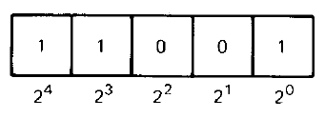
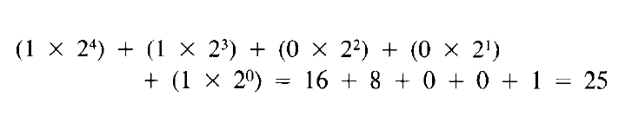
Binary Weights
Even in binary number, each bit has a positional weight
Since only two digits or bits are used, the weights are powers of 2, instead of 10
Example: 11001 in binary

Slide 15
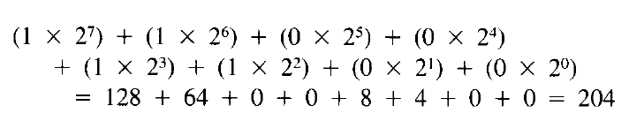
Binary to Decimal Conversion
Convert binary 11001100 into decimal
So, binary 11001100 in decimal is 204

Slide 16
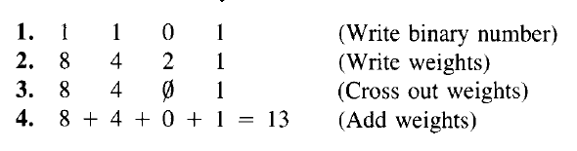
Binary to Decimal Conversion – Faster/8421 Method
Write the binary number
Write the weights 1, 2, 4, 8, 16, … under the bits from right to left
Cross out weights under a 0
Add the remaining weights
Example: Convert binary 1101 into decimal

Slide 17

Binary to Decimal – Even Shorter Method
Convert binary 1110101 to decimal

Slide 18
Base or Radix
Base or radix of a number system is equal to the number of digits it has
Decimal number system’s base is 10 (Digits 0-9 are used)
Binary number system’s base is 2 (Digits 0-1 are used)
A subscript denotes the base
Examples:
100₁₀ is decimal 100 (hundred)
100₂ is binary 100 (one zero zero)
So, we can say that 1101₂ = 13₁₀

Slide 19
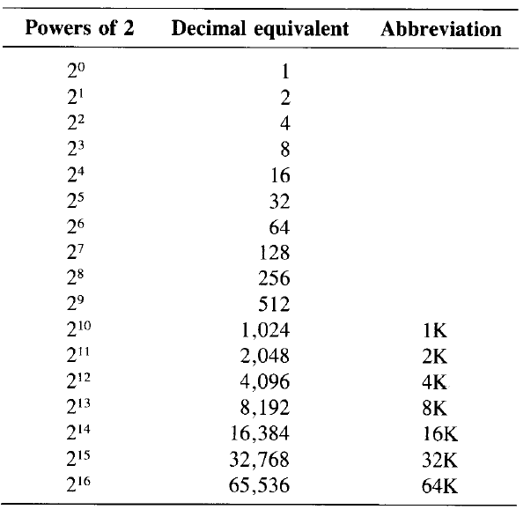
Measuring bits – the K Notation

Slide 20
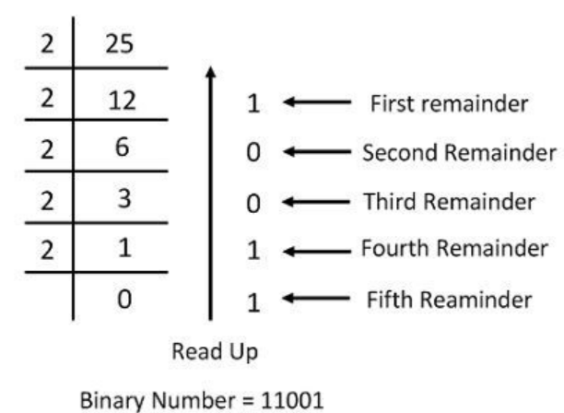
Decimal to Binary Conversion
Write the decimal number
Divide it by 2 and write the quotient and remainder
Keep doing it till we get a quotient of 0
Write the remainder in the reverse order to get the binary number

Slide 21
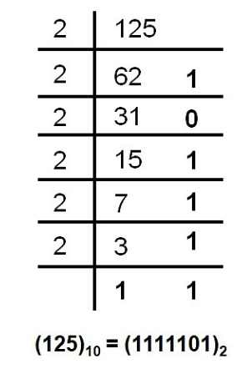
Decimal to Binary – Example
Convert decimal 125 into binary

Slide 22
Key Terminology
Bit: One single 0 or 1
Nibble: Group of 4 bits (Half-byte)
Byte: Group of 8 bits
Word: Group of 2 bytes (16 bits)
Bit
0 | 0 | 1 | 1 | 0 | 1 | 1 | 0
Byte
0 | 0 | 1 | 1 | 0 | 1 | 1 | 0
Word
Nibble

Slide 23
Hexadecimal Numbers
Hexadecimal (hex) numbers: Used in microprocessor work
Much shorter than binary numbers (e.g. 10101101011 in binary is 56B in hex)
Hexadecimal: Hex + Decimal = 6 + 10 = 16 symbols: Digits 0 to 9 and letters A to F
So, 0 to 9 then A to F then reset to 0

Slide 24
Hexadecimal Odometer
0000 Zero
0001 One
0002 Two
0003 Three
…
0009 Nine
000A Ten
000B Eleven
000C Twelve
000D Thirteen
000E Fourteen
000F Fifteen

Slide 25
Hexadecimal Odometer
000F Fifteen
0010 Sixteen
0011 Seventeen
…
0019 Twenty five
001A Twenty six
001B Twenty seven
…
0020 Thirty two

Slide 26
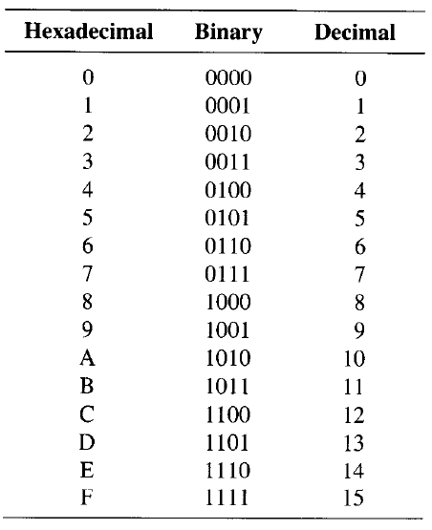
Equivalence

